Slide 1


Dermoscopic Interest Point Detector and Descriptor
Howard Zhou¹, Mei Chen², James M. Rehg¹
  ¹School of Interactive Computing, Georgia Tech
  ²Intel Research Pittsburgh

Slide 2
Skin cancer
Skin cancer : most common type of cancer ( > 1 million )
[ Top 5 categories of estimated annual cancer incidence for 2009 from National Cancer Institute ]
Notes:
This work is an on going research project for computer-aided skin cancer diagnosis. First some facts on skin cancer. Skin cancer is the most common type of cancer that occur in human. There are more than 1 million cases diagnosed in the United States every year, significantly more than other types of cancers.
Skin cancer: Cancer that forms in tissues of the skin. There are several types of skin cancer. Skin cancer that forms in melanocytes (skin cells that make pigment) is called melanoma. Skin cancer that forms in basal cells (small, round cells in the base of the outer layer of skin) is called basal cell carcinoma. Skin cancer that forms in squamous cells (flat cells that form the surface of the skin) is called squamous cell carcinoma. Skin cancer that forms in neuroendocrine cells (cells that release hormones in response to signals from the nervous system) is called neuroendocrine carcinoma of the skin. Most skin cancers form in older people on parts of the body exposed to the sun or in people who have weakened immune systems.
According to the latest statistics available from the National Cancer Institute and the Centers for Disease Control and Prevention (CDC):
Skin cancer is the most common of all cancers in the United states.
More than 1 million cases of non-melanoma skin cancer are diagnosed in the US each year.
Melanoma is the leading cause of mortality among all forms skin cancer. Melanoma represents only 4 percent of all skin cancers in the US, but accounts for more than 75 percent of all skin cancer deaths.
statistics from the American Cancer Society and the American Academy of Dermatology:
Nevertheless, melanoma can often be cured with a simple excision if caught in early stage. Hence, early detection of malignant melanoma significantly reduces mortality.
Both basal cell and squamous cell carcinomas have a 95 percent cure rate when detected and treated early.
Melanoma is more common than any non-skin cancer among women between 25 and 29 years old.

Slide 3
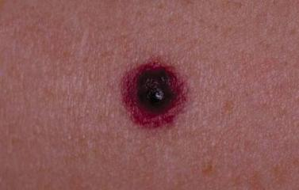
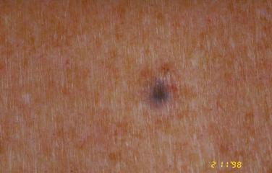
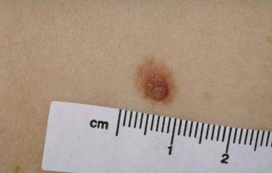
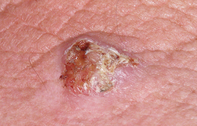
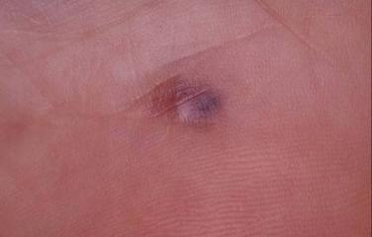
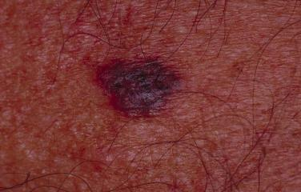
Skin cancer
Skin cancer : most common type of cancer ( > 1 million )
forms in tissues of the skin
Skin lesions
[ Image courtesy of “An Atlas of Surface Microscopy of Pigmented Skin Lesions: Dermoscopy” ]
Notes:
Skin cancer forms in tissues of the skin.

Slide 4
Skin cancer
Skin cancer : most common type of cancer ( > 1 million )
forms in tissues of the skin
Benign lesions
Skin cancer
[ Image courtesy of “An Atlas of Surface Microscopy of Pigmented Skin Lesions: Dermoscopy” ]
Notes:
To detect cancer among a large variety of skin lesions

Slide 5
Skin cancer
Skin cancer : most common type of cancer ( > 1 million )
forms in tissues of the skin
Benign lesions
Skin cancer
Basal cell
carcinoma
Squamous cell
carcinoma
Melanoma
[ Image courtesy of “An Atlas of Surface Microscopy of Pigmented Skin Lesions: Dermoscopy” ]
Notes:
Or to classifies different types of skin cancers

Slide 6
Dermoscopy
Non-invasive imaging technique
Improve diagnostic accuracy by 30%
Skin cancer
Basal cell
carcinoma
Squamous cell
carcinoma
Melanoma
[ Image courtesy of “An Atlas of Surface Microscopy of Pigmented Skin Lesions: Dermoscopy” ]
Notes:
Clinicians nowadays often relies on a non-invasive imaging technique called dermoscopy, which is shown to improve diagnostic accuracy by 30 % in the hands of trained physicians
Take this melanoma, a highly dangerous type of skin cancer, for example

Slide 7
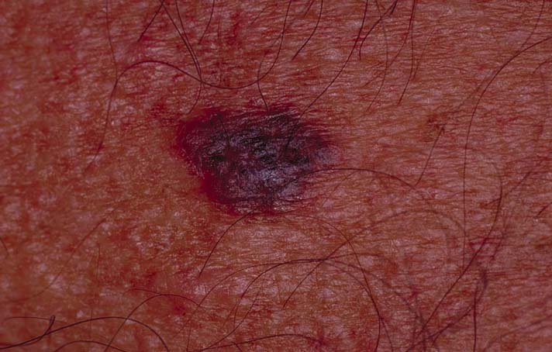
Dermoscopy
Non-invasive imaging technique
Improve diagnostic accuracy by 30%
Clinical view
[ Image courtesy of “An Atlas of Surface Microscopy of Pigmented Skin Lesions: Dermoscopy” ]
Notes:
Under clinical view, it is hard to discern any dermal structures due to light reflected and scattered by the top layer of the skin

Slide 8
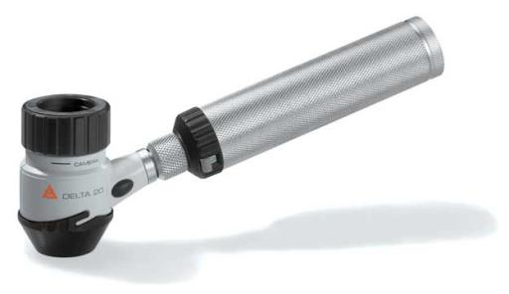
Dermoscopy
Non-invasive imaging technique
Improve diagnostic accuracy by 30%
Microscope + light + liquid medium
Dermatoscope
[ Image courtesy of “An Atlas of Surface Microscopy of Pigmented Skin Lesions: Dermoscopy” ]
Notes:
However, by using a combination of microscope, incident light source, and liquid medium

Slide 9
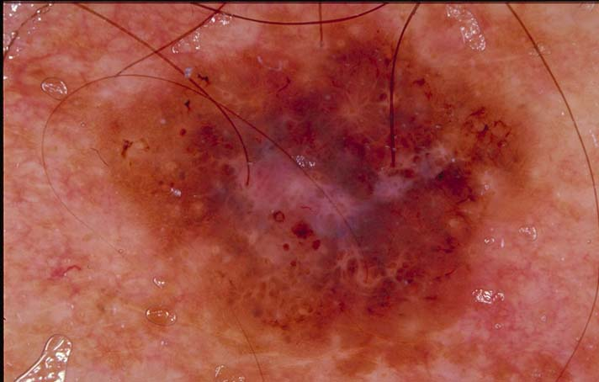
Dermoscopy
Non-invasive imaging technique
Improve diagnostic accuracy by 30%
Microscope + light + liquid medium
Reveal pigmented structures
Dermatoscope
Dermoscopy view
[ Image courtesy of “An Atlas of Surface Microscopy of Pigmented Skin Lesions: Dermoscopy” ]
Notes:
The same lesion would reveal much more to the observer under the dermatoscope
Dermoscopy is also known as skin surface microscopy. It is a noninvasive imaging procedure which involves using an incident light magnification system, i.e. a dermatoscope, to examine skin lesions. Often oil is applied at the skin-microscope interface. This allows the incident light to penetrate the top layer of the skin tissue and reveal the pigmented structures beyond what would be visible by naked eyes.
For dermatologists who have become experienced with this imaging technique, dermoscopy has been shown to improve the diagnostic accuracy by as much as 30% over clinical examination. However, it may require as much as 5 year experience to have the necessary training.
This is part of the motivation for computer-aided diagnosis in this area
In recent years, there has been increasing interest in computer-aided diagnosis of pigmented skin lesion from these dermoscopy images. In the future, with the development of new algorithms and techniques, these computer procedures may aid the dermatologists to bring medical break through in early detection of melanoma.

Slide 10
Dermoscopic features
Pigmented structures revealed by dermoscopy
Dermoscopy view
[ Image courtesy of “An Atlas of Surface Microscopy of Pigmented Skin Lesions: Dermoscopy” ]
Notes:
Dermoscopy allows the incident light to penetrate the top layer of the skin tissue and reveal the pigmented structures beyond what would be visible by the naked eye.
Many of these structures appear often in skin lesions and are called dermoscopic features

Slide 11
Dermoscopic features
Pigmented structures revealed by dermoscopy
Dermoscopy view
Blue-white veil
[ Image courtesy of “An Atlas of Surface Microscopy of Pigmented Skin Lesions: Dermoscopy” ]
Notes:
For example, this kind of milky glassy blue-white pigmentation is called blue-white veil

Slide 12
Dermoscopic features
Pigmented structures revealed by dermoscopy
Dermoscopy view
Blue-white veil
Scar-like depigmentation
[ Image courtesy of “An Atlas of Surface Microscopy of Pigmented Skin Lesions: Dermoscopy” ]
Notes:
These less colorful regions that look like scars are called scar-like depigmentation

Slide 13
Dermoscopic features
Pigmented structures revealed by dermoscopy
Dermoscopy view
Blue-white veil
Scar-like depigmentation
Brown globules
[ Image courtesy of “An Atlas of Surface Microscopy of Pigmented Skin Lesions: Dermoscopy” ]
Notes:
Here are some brown dots and globules

Slide 14
Dermoscopic features
Pigmented structures revealed by dermoscopy
Dermoscopy view
Blue-white veil
Scar-like depigmentation
Brown globules
Negative network
[ Image courtesy of “An Atlas of Surface Microscopy of Pigmented Skin Lesions: Dermoscopy” ]
Notes:
And here is a rare type of dermoscopic feature called negative network.
These dermoscopic features, through their sensitivity and specificity associated with different skin cancers, provide important clues to dermatologists for making accurate diagnoses. Therefore, being able to detect these features is essential to Computer-Aided Diagnosis of skin cancer.

Slide 15
Dermoscopic features
Pigmented structures revealed by dermoscopy
[Betta et al. 2006], [Grana et al. 2006], [Iyatomi et al. 2007],…
Dermoscopy view
Blue-white veil
Scar-like depigmentation
Brown globules
Negative network
[ Image courtesy of “An Atlas of Surface Microscopy of Pigmented Skin Lesions: Dermoscopy” ]
Notes:
Over the years, many methods have been proposed for detection and classification of these indicative dermoscopic features.
To name a few, we list here some recent work.
However, these approaches are often binary classifiers for individual dermoscopic features.
Detect and classify atypical pigmented network and vascular patterns [Betta et al. 2006]
Detect curvilinear features to characterize network patterns [Grana et al. 2006]
Classify parallel furrow and ridge patterns for acral lesions [Iyatomi et al. 2007]
Classify three common global patterns [Tanaka et al. 2008]
However, these approaches often employ binary classifiers for individual dermoscopic features.

Slide 16
Dermoscopic features
Over 100 dermoscopic features
Dermoscopy view
Blue-white veil
Scar-like depigmentation
Brown globules
Negative network
…
[ Image courtesy of “An Atlas of Surface Microscopy of Pigmented Skin Lesions: Dermoscopy” ]
Notes:
Since there are over 100 dermoscopic features in total, and often there are multiple features present in a typical lesion
Detect and classify atypical pigmented network and vascular patterns [Betta et al. 2006]
Detect curvilinear features to characterize network patterns [Grana et al. 2006]
Classify parallel furrow and ridge patterns for acral lesions [Iyatomi et al. 2007]
Classify three common global patterns [Tanaka et al. 2008]

Slide 17
Dermoscopic features
Over 100 dermoscopic features
Multiple binary classifiers for each image
Dermoscopy view
Blue-white veil
BW classifier
Scar-like depigmentation
SLD classifier
BG classifier
Brown globules
Negative network
NN classifier
…
…
[ Image courtesy of “An Atlas of Surface Microscopy of Pigmented Skin Lesions: Dermoscopy” ]
Notes:
This means that for each dermoscopy image, we would be required to run multiple binary feature classifiers, which would become very costly if we want to detect many features.

Slide 18
Dermoscopic features
General detector?
Dermoscopy view
Blue-white veil
Scar-like depigmentation
Generalized detector
Brown globules
Negative network
…
[ Image courtesy of “An Atlas of Surface Microscopy of Pigmented Skin Lesions: Dermoscopy” ]
Notes:
So how do we avoid this brute force approach and build a generalized feature detector to replace the individual binary classifiers.

Slide 19
Dermoscopic features
General detector?
Dermoscopy view
Blue-white veil
Scar-like depigmentation
Generalized detector
Brown globules
Negative network
…
Dermoscopic features consist of low level image characteristics (ridges, blobs, streaks, pigmentation,…)
[ Image courtesy of “An Atlas of Surface Microscopy of Pigmented Skin Lesions: Dermoscopy” ]
Notes:
Here, we observe that dermoscopic features consist of low level image characteristics such as ridges, blobs, streaks and pigmentation.

Slide 20
Dermoscopic features
General detector?
Dermoscopy view
Blue-white veil
Scar-like depigmentation
Generalized detector
Brown globules
Negative network
…
Dermoscopic features consist of low level image characteristics (ridges, blobs, streaks, pigmentation,…)
→ interest points
[ Image courtesy of “An Atlas of Surface Microscopy of Pigmented Skin Lesions: Dermoscopy” ]
Notes:
If we can represent these low level image characteristics as, say, interest points

Slide 21

Dermoscopic Interest Point (DIP)
General detector: concentration/configuration of interest points
bag-of-visual-words approach
Dermoscopy view
Generalized detector
Blue-white veil
Scar-like depigmentation
Brown globules
Negative network
…
Dermoscopic features consist of low level image characteristics (ridges, blobs, streaks, pigmentation,…)
→ interest points
[ Image courtesy of “An Atlas of Surface Microscopy of Pigmented Skin Lesions: Dermoscopy” ]
Notes:
Then we can use the bag-of-visual-words approach.
by looking at distinct spatial configuration and concentration of these dermoscopic interest points, we can build a detector and multi-classifier for dermoscopic features

Slide 22
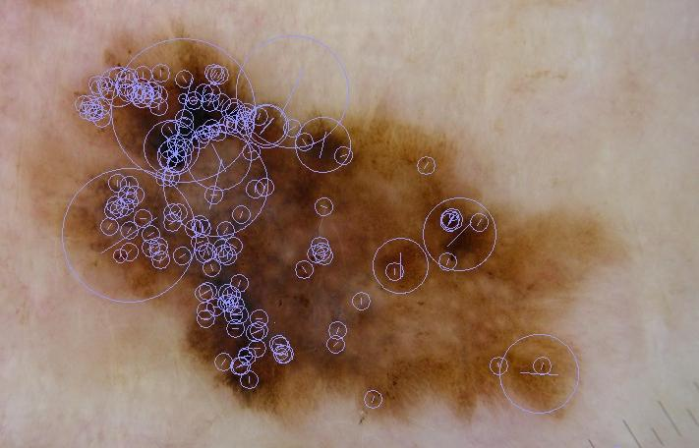
Dermoscopic Interest Point (DIP)
Inspired by general interest point detector and descriptors (SIFT & SURF)
We propose Dermoscopic Interest Point (DIP)
  detector - to extract these low level building blocks
  descriptor – for constructing a general visual vocabulary for dermoscopic features
Notes:
Inspired by recent success of general interest point detector and descriptors such as SIFT and SURF in computer vision, we propose a dermoscopic interest point detector and descriptor specifically designed as a low level representation for dermoscopy features.

Slide 23
Dermoscopic Interest Point (DIP)
Compared to the general interest point detector and descriptors (SIFT & SURF)
Same key issues
  Repeatable
  Distinctive
  Robust to noise and deformation (geometric and photometric)
Similar to SIFT & SURF
  Corners and blobs
  Scale and rotation invariant
In addition
  Curvilinear features (fibrillar pattern and radial streaming)
  Color component
Notes:
Similar to the general interest point detector and descriptors such as SIFT & SURF, we need to address the same issues: the detector has to be repeatable: it has to find the same interest points under different viewing condition,
and the descriptor has to be distinctive, but also robust to noise and geometric and photometric deformation.
So naturally, DIP borrows from these general interest point detector and it is very similar in that the detector also latches on to corners and blobs, and achieves scale and rotation invariant
In addition, for the specific task of representing dermoscopic features,
We design our detector to also respond to curvilinear features for streaks and fibrillar patterns often seen in skin lesions.
We also add a color component to the descriptor since pigmentation is one of the most important visual cue for dermoscopic features
Next, we will go into details on how to build the dermoscopic interest point detector and descriptor

Slide 24
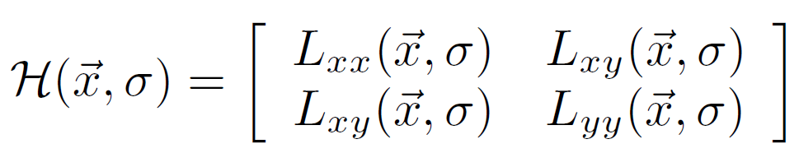
Detector
Corners and blobs
  Fast-Hessian detector [Bay, et al. 2006]
Hessian matrix
Notes:
We first look at how we detect dermoscopic interest points.
We adopt the fast-hessian detector introduced by Bay et al. for corners and blobs.
The detector finds blob-like structures at locations where the determinant of the Hessian matrix is maximum.
Given a point x = (x; y) in an image I, the Hessian matrix H(x; sigma) in x at scale sigma is defined like this, where Lxx(x; sigma) is the convolution of the Gaussian 2nd order derivative with the image I in point x.

Slide 25
Detector
Corners and blobs
  Fast-Hessian detector [Bay, et al. 2006]
  Box filter approximation to replace Gaussian derivatives
  Fast using Integral image
Hessian matrix
Notes:
As shown by Bay, et al., the Gaussian derivatives can be approximated by box filters. Consequently, the Hessian calculation can be sped up significantly by using integral images.

Slide 26
Detector
Corners and blobs
  Fast-Hessian detector [Bay, et al. 2006]
Curvilinear structures
  Curvilinear detector [Steger, 1996]
Hessian matrix
Notes:
In addition to the corner and blob detector, our detector also needs to catch distinctive curvilinear features for detecting fibrillar patterns and streaks common to many dermoscopic features.
Here, we use the curvilinear point detector.

Slide 27
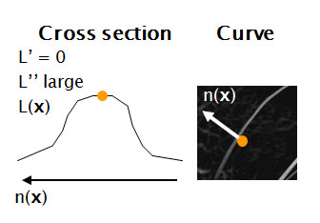
Detector
Corners and blobs
  Fast-Hessian detector [Bay, et al. 2006]
Curvilinear structures
  Curvilinear detector [Steger, 1996]
Hessian matrix
Notes:
Curvilinear (or line) points are points in an intensity image where the first directional derivative in the direction of the line vanishes, and the second derivative has a large absolute value.

Slide 28
Detector
Corners and blobs
  Fast-Hessian detector [Bay, et al. 2006]
Curvilinear structures
  Curvilinear detector [Steger, 1996]
Hessian matrix
Notes:
A point x = (x; y) is a line point if it satisfies this equation
where (nx; ny) is the normalized eigenvector that corresponds to the maximum absolute eigenvalue of the local Hessian matrix,

Slide 29
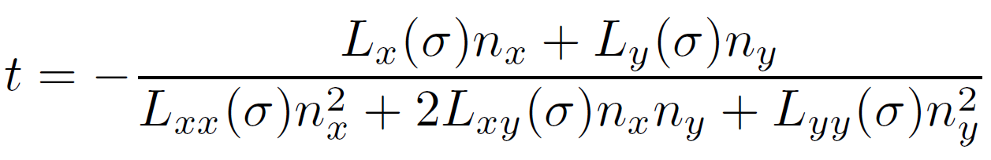
Detector
Corners and blobs
  Fast-Hessian detector [Bay, et al. 2006]
Curvilinear structures
  Curvilinear detector [Steger, 1996]
Hessian matrix
Notes:
and t is evaluated as shown, where Lx, Ly, Lxx, Lxy, Lyy are partial derivatives of the image convolving with 2D Gaussian derivatives. Here, the same box filter approximation can be used for efficiency.
Equipped with the detector to find both corners/blobs and curvilinear structures, interest points in a dermoscopy images can be located. Now we will briefly describe our scheme to encode the information at these dermoscopic interest point sites.

Slide 30
Descriptor
Distinctiveness
  Spatially localized information
  Distribution of gradient-related features
  Dermscopic: color features
Invariance (Repeatability)
  Relative strength to reduce the effect of photometric changes
  Relative orientation for rotation invariance
Notes:
The distinctive power of state-of-the-art interest point descriptors relies on a combination of spatially localized information and the distribution of gradient-related features.
Relative strengths and orientations are often used to reduce the effect of photometric, scale, and rotation changes. The proposed dermoscopic feature descriptor is based on similar properties, with the addition of the color component.

Slide 31
Descriptor
Distinctiveness
  Spatially localized information
  Distribution of gradient-related features
  Dermscopic: color features
Invariance (Repeatability)
  Relative strength to reduce the effect of photometric changes
  Relative orientation for rotation invariance
To construct
  Reproducible orientation
Notes:
To construct the descriptor, from the circular region around each interest point.

Slide 32
Descriptor
Distinctiveness
  Spatially localized information
  Distribution of gradient-related features
  Dermscopic: color features
Invariance (Repeatability)
  Relative strength to reduce the effect of photometric changes
  Relative orientation for rotation invariance
To construct
  Reproducible orientation
Notes:
We first identify a reproducible orientation that is based on local statistics calculated within the circular region.

Slide 33
Descriptor
Distinctiveness
  Spatially localized information
  Distribution of gradient-related features
  Dermscopic: color features
Invariance (Repeatability)
  Relative strength to reduce the effect of photometric changes
  Relative orientation for rotation invariance
To construct
  Reproducible orientation
  Feature vector
Notes:
We then construct a square region aligned to this orientation and extract a feature vector from it.
This feature vector encoding local intensity and color statistics will be used as our descriptor

Slide 34
Descriptor
Orientation
  For rotation invariance
  Haar-wavelet responses in x and y direction (in a circular neighborhood)
Notes:
Our first step is to find a reproducible orientation in order to achieve rotation invariance.
We first compute the Haar-wavelet responses in both x and y direction in a circular neighbourhood of around it.

Slide 35
Descriptor
Orientation
  For rotation invariance
  Haar-wavelet responses in x and y direction (in a circular neighborhood)
  Reponses represented as 2D vectors
dy
dx
Notes:
The resulting responses are represented as vectors in a 2D space

Slide 36
Descriptor
Orientation
  For rotation invariance
  Haar-wavelet responses in x and y direction (in a circular neighborhood)
  Reponses represented as 2D vectors
  Average responses in a sliding window of 60 degree
dy
dx
Notes:
The dominant orientation is estimated by summing up all the respective horizontal and vertical responses in a sliding window covering an angle of 60 degree.

Slide 37
Descriptor
Orientation
  For rotation invariance
  Haar-wavelet responses in x and y direction (in a circular neighborhood)
  Reponses represented as 2D vectors
  Average responses in a sliding window of 60 degree
  The longest vector indicates the orientation
dy
dx
Notes:
The orientation of the longest such vector is chosen as the orientation of the interest point.

Slide 38
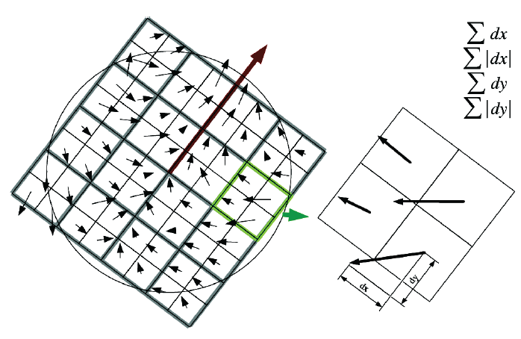
Descriptor
Descriptor components
  Context of the descriptor: a square region oriented along the orientation (centered around the interest point)
  Local statistics
    Uniform 4 x 4 subregions
    Intensity gradients (I): Sum of Haar-wavelet responses: dx, dy, |dx|, |dy|
    Color statistics (C): Coarse color histogram of the region (alpha & beta channels in L*a*b space)
[ Image courtesy of Bay et al. 2006]
Notes:
Once a reproducible orientation is fixed, we can construct a square region oriented along this direction centered around the interest point.
This square defines the context of our descriptor. We divide it uniformly into 4 x 4 sub-regions, we compute 4 features from uniformly sample points for each sub region
They are dx, dy (Haar wavelet responses) and the absolute values |dx| |dy| to register the polarity of the intensity changes.
We sum up these 4 measurements within each sub-region and obtain a length 64 vector for all 4 x 4 sub regions.
The wavelet responses are invariant to illumination changes, and we can further achieve contrast invariance by normalizing the descriptor into a unit vector.
Popular interest point descriptors only compute intensity statistics and discard color information. However, we notice color is an important diagnostic cue in dermoscopy images since we are interested in pigmented skin lesions. Therefore, we include color statistics to augment our descriptor.
For each region surrounding an interest point, we compute a coarse color histogram in the alpha and beta channels of the L*a*b* representation (since the intensity statistics of L are already accounted for. The resulting vector captures the color statistics of the context region
This color component is normalized and concatenated to the intensity component to form a DIP descriptor.

Slide 39
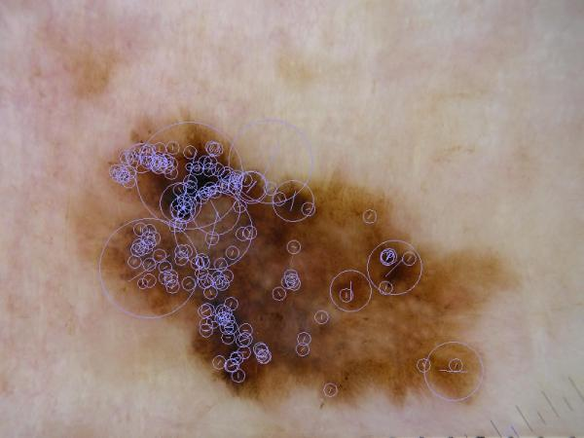
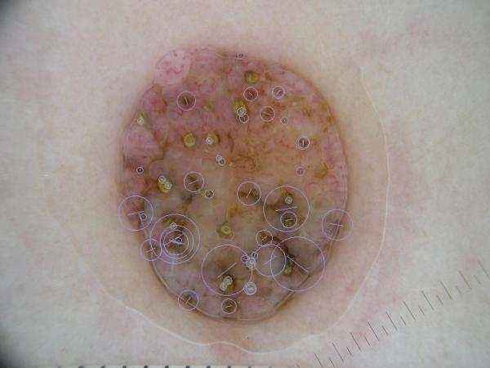
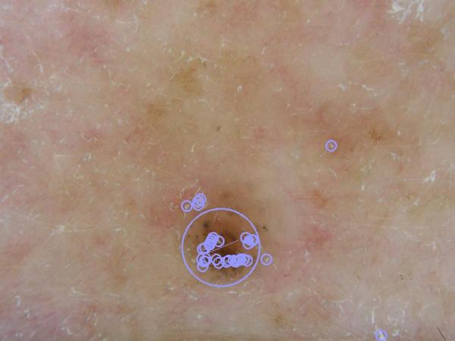
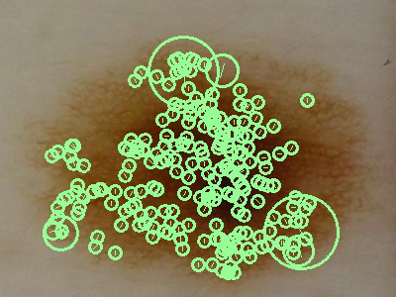
Dermoscopy Interest Point
Notes:
Here are some examples of dermoscopic interest points detected on typical dermscopy images.
The DIP detector is applied to the segmented lesion area. The diameter of the circle shows the scale of the interest point, which is the context region included in the calculation of the descriptor. The little bars in the circle indicates the orientation.

Slide 40
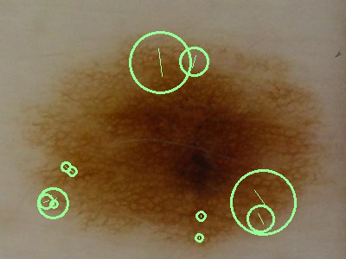
Dermoscopy specific
Common interest point descriptor ignores linear features
SURF
DIP
Notes:
This figure shows the SURF and DIP detection results.
The lesion in the images exhibits a common dermoscopy feature called pigmented networks.
There are only a few corners and blobs strong enough to trigger SURF detector responses, however, under the same settings, the DIP detector captures more interest points on the same lesion, and a higher percentage of these DIP responses are relevant to dermoscopic features (That is, They fall in the interest region delineated by our dermatologists.)

Slide 41
Experiment
Notes:
For quantitative evaluation, we evaluate our representation on a dataset of 150 dermoscopy images.
At least one dermoscopic feature is present within each lesion boundary. The features are outlined and annotated by our collaborating dermatologists.
We compare DIP to SURF and SIFT. (SURF is based on the original implementation of the authors, and SIFT is from a relatively efficient implementation based on the original publication. )
(We first compare how sensitive these detectors are to dermoscopic features. We then check their repeatability on dermoscopy images undergoing common transformations.)
For each dermoscopy image, all the detector responses within the lesion boundary are retrieved. Those points that land inside dermatologists’ manual feature outlines are considered relevant. The starting threshold for each detector is set to a low level to generate a large number of responses. These responses at the lowest threshold are used as the relevant feature set for each detector. As we gradually increase the threshold, fewer responses are produced. We plot the precision-recall graph in the first figure.
According to the precision-recall graph, a higher percentage of these DIP responses are relevant to dermoscopic features compared to SURF and SIFT on dermoscopy images.
To demonstrate the repeatability of our detector and descriptor, we perform a set of scale, rotation, and lighting change operations on each image. The detector responses at each location before and after the change are matched; any inconsistency indicates a miss detection. The results are shown in the next three figures.
Although the DIP detector often extracts more interest points than the others, its repeatability is comparable to SURF and SIFT

Slide 42
Conclusion
A generalized framework for characterizing dermoscopic features using Dermoscopic Interest Point (DIP)
A feature detector and a descriptor specifically designed for this purpose
Initial experiments showed that our scheme achieves a comparable level of invariance to lighting, scale, and rotation changes
Notes:
In conclusion, we propose a generalized framework for characterizing dermoscopic features using dermoscopic interest point.
We introduce a feature detector and a descriptor designed specifically for this purpose. Initial experiments showed that our scheme achieves a comparable level of invariance to light, scale and rotation changes.

Slide 43
Future work
Build a vocabulary of dermoscopic features using DIP
Explore the possibility of using DIP in skin CAD related applications:
  Dermoscopic feature extraction and classification
  Dermoscopy image registration
  Dermoscopy image search and retrieval via dermoscopic features
Notes:
For future work, we plan to build a vocabulary of common dermoscopic features using dermoscopic interest points.
We also want to use these interest points for applications such as dermoscopic feature extraction and classification, image registration, and dermoscopy image search and retrieval using dermoscopic features.

Slide 44
Acknowledgement
Collaborators (in alphabetical order)
  Dr. Laura K. Ferris M.D. Ph.D. UPMC
  Richard Gass, Intel Research Pittsburgh
  Casey Helfrich, Intel Research Pittsburgh
Many thanks to our anonymous reviewers for their helpful comments and suggestion
Notes:
Finally, I want to thank our collaborators and the ISBI reviewers for their helpful comments and suggestions.

Slide 45
Thank you
Thank you !
Notes:
Thank you for your attention

Slide 46
Related publications
Interest pointer detector and descriptors
  Distinctive image features from scale-invariant keypoints
  David G. Lowe
  Intl. J. of Computer Vision (IJCV), 2004
  Surf: Speeded up robust features
  Herbert Bay, Tinne tuytelaars, and Luc Van Gool,
  in Eur. Conf. on Computer Vision (ECCV), 2006
  An unbiased detector of curvilinear structures
  Carsten Steger,
  IEEE Trans. Pattern Anal. Machine Intell.(PAMI) 1996

Slide 47
Outline
Introduction
Detector
  Corners and blobs
  Curvilinear structures
Descriptor
  Orientation
  Descriptor components
Validation
Conclusion

Slide 48




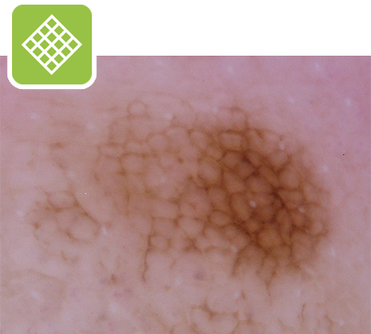
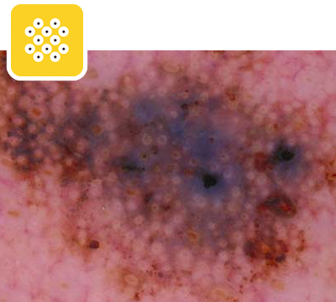








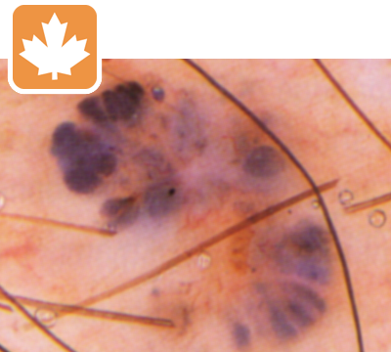
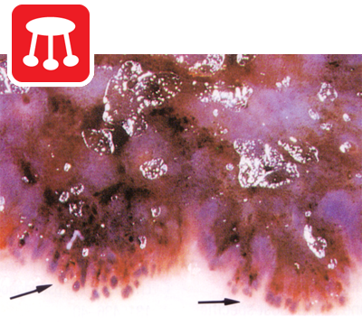








Dermoscopic features
A Pigmented Skin Lesion (PSL) typically has several dermoscopic features
Over 100 of these features

Slide 49
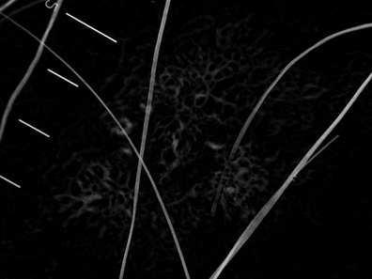
Detecting line points
Cross section
Curve
L’ = 0
L’’ large
n(x)
L(x)
n(x)
[ Steger 1998, ”An Unbiased Detector of Curvilinear Structures” ]
Notes:
Which point is a line point
The detection algorithm regards the gray level image as a surface in which pixel intensity corresponds to surface height. The line points are points where the first directional derivative in the direction of the line vanishes and the second directional derivative have a large absolute value.
A point (x, y) is a line point if it satisfies (t*nx, t*ny) \in [-1/2, ½] x [-1/2, ½].
where (nx, ny) points to the direction perpendicular to the line direction at point (x, y), it is the normalized eigenvector that corresponds to the maximum absolute eigenvalue of the local Hessian matrix H(x, y), and t is evaluated as the equation:
rx, ry, rxx, rxy, ryy are partial derivatives of the image estimated by convolving the image with discrete two-dimensional Gaussian partial derivative kernels.
The sigmas of these kernels is directly tied to the expected line width. Therefore, we apply the line detection algorithm at multiple scales (with different sigma) to extract line segments within a certain width range. The image on the right shows the line points detected
The saliency of a line point (x, y), i.e. the absolute value of the second directional derivative along (nx, ny), is inversely proportional to its intensity.
After individual line points are identified, we trace through neighboring points to link these them into line segments i.e. sets of ordered points. Notice the result of this

Slide 50
Experiment

