Slide 1
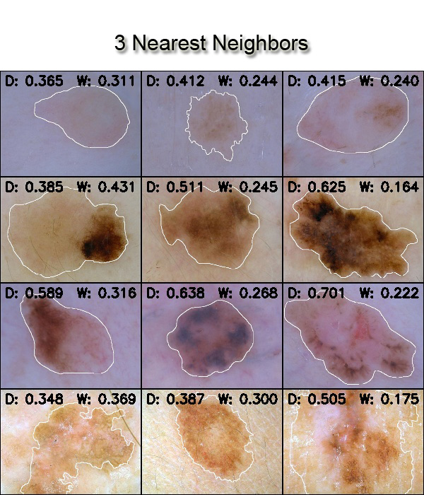
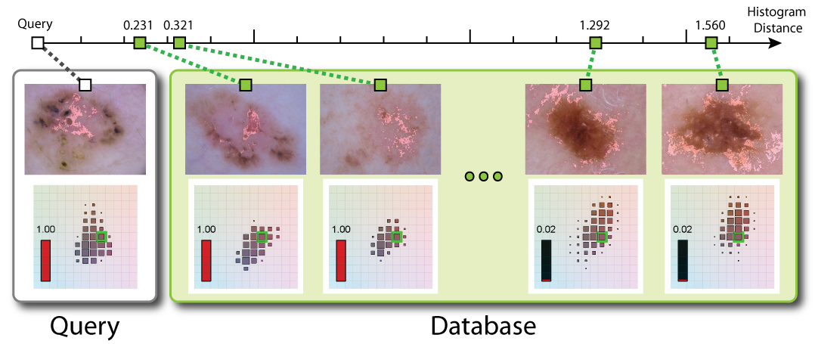
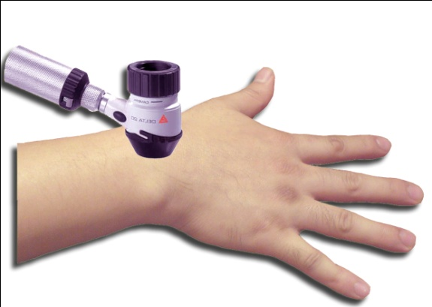
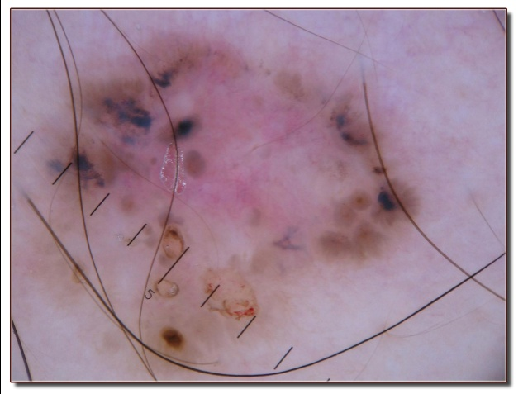
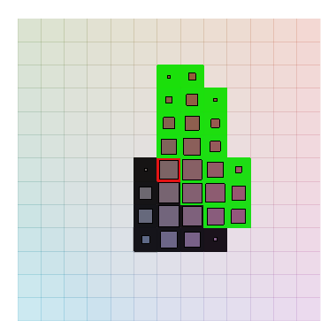
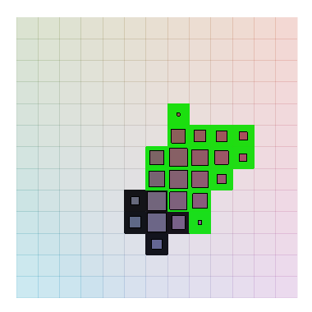
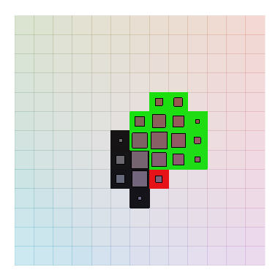
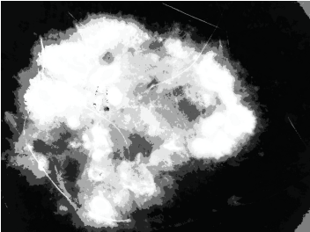
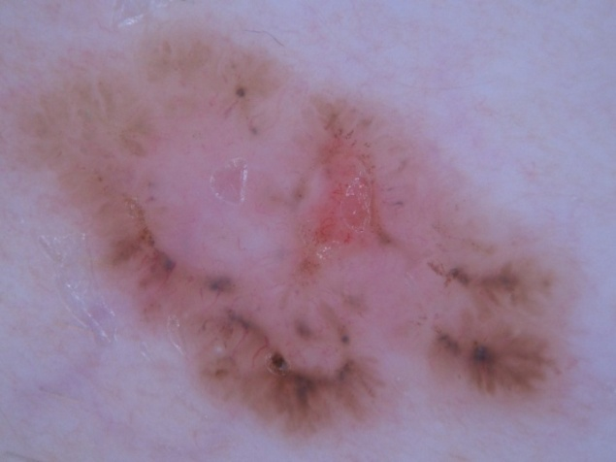
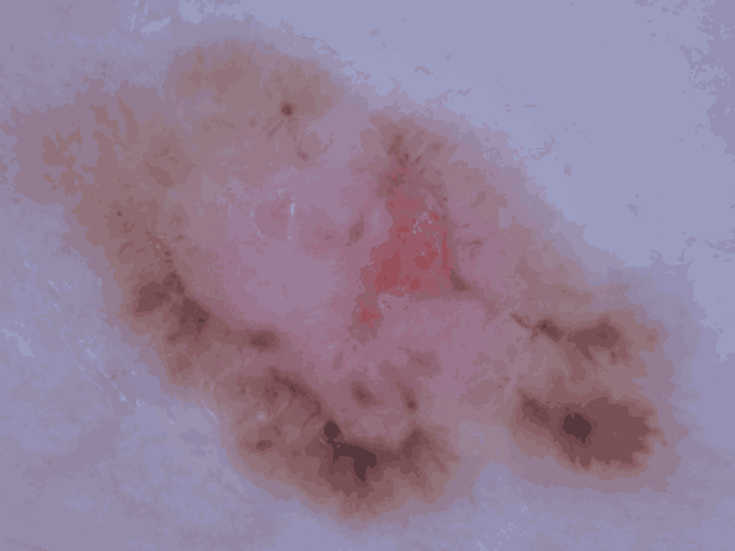
Exemplar-Based Segmentation of Pigmented Skin Lesions from Dermoscopy Images
Howard Zhou, James M. Rehg {howardz,rehg}@cc.gatech.edu School of Interactive Computing, College of Computing, Georgia Institute of Technology
Mei Chen mei.chen@intel.com Intel Labs Pittsburgh
Motivation
Exemplar-Based Pixel Classifier
New Image
3 Nearest Neighbors
EBC
SEBC
Skin cancer: world’s most common of all cancers
Early detection and treatment pivotal to survival
Dermoscopy: non-invasive imaging that improves early detection by 25% with training+experience
Automated analysis of dermoscopy provides assistance to the less trained/experienced
Each pre-segmented image in the database
Compute overall color histogram (key )
Compute skin/lesion histogram (value )
New image
Find close neighbors in the database using the key
Back-project the average value to get a pixel-wise probability map.
Dermoscope
Evaluation
Ground-truth segmentation by human experts
Border Error :
Goal
New Image
Database of pre-segmented images
Automated segmentation of Pigmented Skin Lesions (PSL) from dermoscopy images
Original
Ground-truth
SEBC
EBC
SCS
SRM
JSEG
Approach
Exemplar-based pixel classification which exploits contextual information from the overall appearance of the lesion and its surrounding skin
Obtain contextual information from similar PSLs in a previously-segmented database
Archieve spatial smoothness by exploiting the growth pattern in PSLs
Maintain Spatial Smoothness
The growth pattern of PSLs exhibit a radiating appearance
Methods | IOE | SEBC | EBC | SCS | SRM | JSEG
D1 (67) | 11.32 | 13.36 | 13.70 | 14.93 | 20.77 | 20.43
D2 (111) | 13.72 | 25.88 | 26.76 | 28.77 | 39.50 | 32.81
D3 (1787) | - | 20.62 | 22.23 | 39.58 | 36.77 | -
Time (sec) | - | 4.37 | 0.45 | 5.72 | 0.46 | 9.67
r
Reference
{R, G, B}
Augment pixel color vectors with a normalized polar radius (0 at image center and 1 at the corners)
Cluster pixels into radially distributed segments of similar colors
Compute skin/lesion labels for each segment
Methods
IOE : Intra-Operator Error, i.e. discrepancies in ground-truth segmentation between two experts
SEBC / EBC: Spatially-smoothed Exemplar-Based pixel Classifier / Exemplar-Based pixel Classifier
SCS : Spatially Constrained Segmentation of Dermoscopy [1]
SRM : Fast and Accurate Border Detection in Dermoscopy Images Using Statistical Region Merging [2]
JSEG : Unsupervised Border Detection in Dermoscopy Images [3]
Datasets
D1: 67 images labeled by two expert dermatologists, and was provided by the authors of [1].
D2: 111 images including examples shown in the first and third rows of the results. It was labeled by two expert dermatologists.
D3: 2159 images from a variety of sources. Ground truth labels for these additional images were provided by a skilled operator.
[1] H. Zhou, et. al. “Spatially constrained segmentation of dermoscopy images,” in International Symposium on Biomedical Imaging, May 2008.
[2] M. Emre Celebi, et. al. “Fast and accurate border detection in dermoscopy images using statistical region merging,” in SPIE Medical Imaging, 2007.
[3] M. Emre Celebi, et. al. “Unsupervised border detection in dermoscopy images,” Skin Research and Technology, November 2007.

